Slide 1

Course Name- Production Technology for Ornamental Crops, MAP and Landscaping
Course Code- 20014400
Presented By- Dr. Mahendra Kr. Yadav
B.Sc. (Ag.) IV Sem. (Production Technology for Ornamental Crops, MAP and Landscaping)

Slide 2
Course Objectives
Identify different types of ornamental and medicinal crops.
Examine various principles of landscaping, uses of landscape trees, shrubs and climbers, production technology of important ornamental crops, etc.
Determine about Demonstrate various Package of practices for loose flowers and their transportation, storage house and required condition for cut and loose flower.
Construct about the various problems with the production technology of medicinal and aromatic plants.
Importance of Processing and value addition in ornamental crops and MAPs produce.
B.Sc. (Ag.) IV Sem. (Production Technology for Ornamental Crops, MAP and Landscaping)

Slide 3

PRODUCTION TECHNOLOGY OF TUBEROSE
UNDER OPEN CONDITIONS
B.Sc. (Ag.) IV Sem. (Production Technology for Ornamental Crops, MAP and Landscaping)

Slide 4
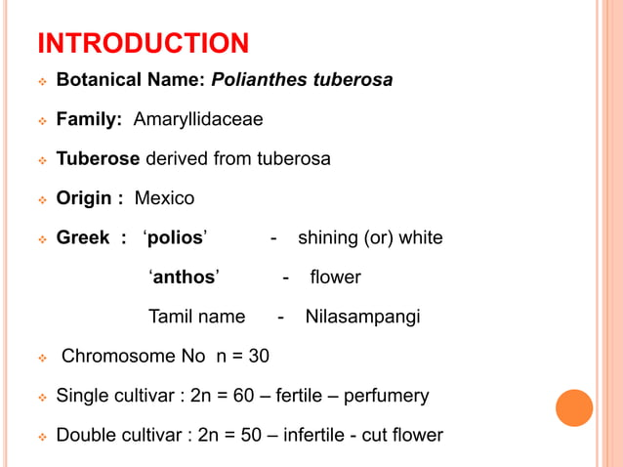
B.Sc. (Ag.) IV Sem. (Production Technology for Ornamental Crops, MAP and Landscaping)

Slide 5
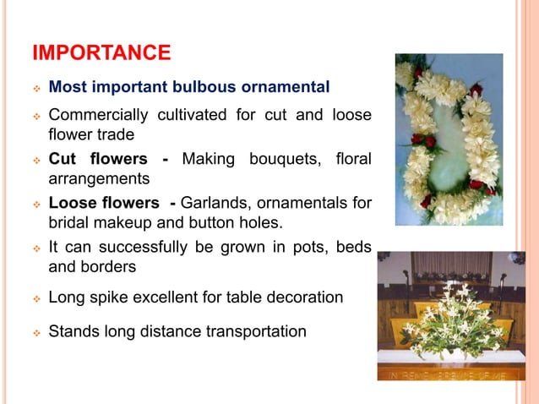
B.Sc. (Ag.) IV Sem. (Production Technology for Ornamental Crops, MAP and Landscaping)

Slide 6
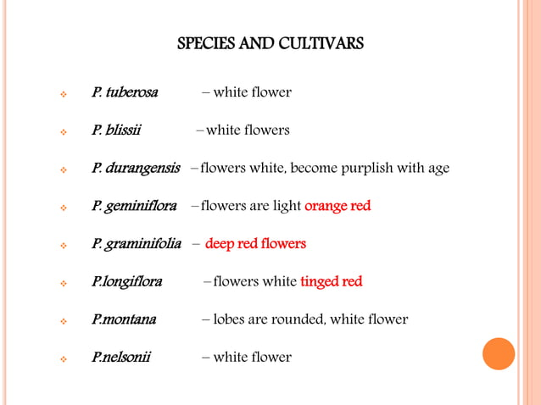
B.Sc. (Ag.) IV Sem. (Production Technology for Ornamental Crops, MAP and Landscaping)

Slide 7
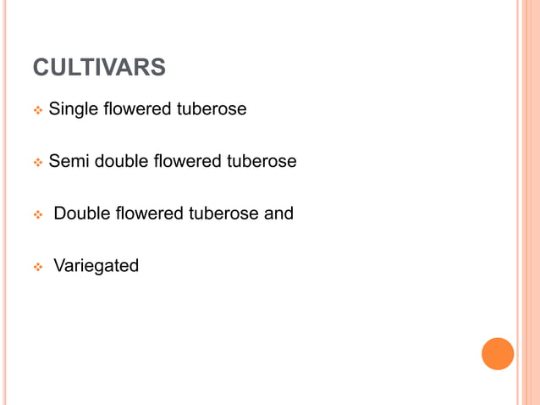
B.Sc. (Ag.) IV Sem. (Production Technology for Ornamental Crops, MAP and Landscaping)

Slide 8
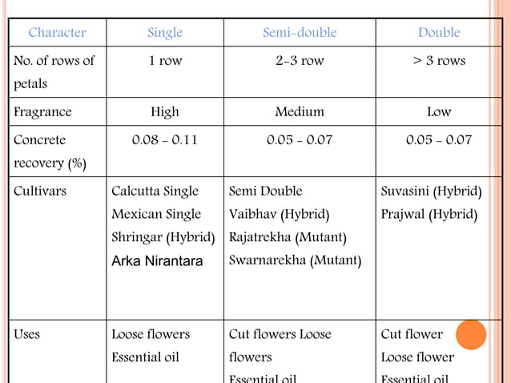
B.Sc. (Ag.) IV Sem. (Production Technology for Ornamental Crops, MAP and Landscaping)

Slide 9
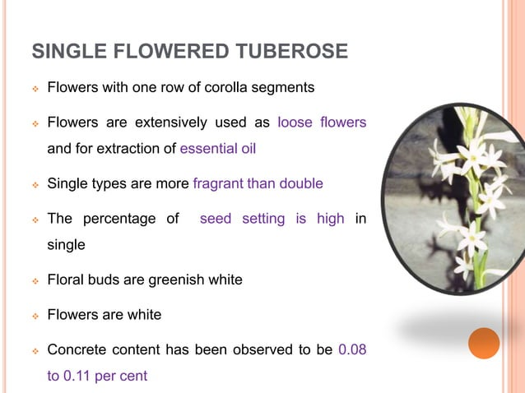
B.Sc. (Ag.) IV Sem. (Production Technology for Ornamental Crops, MAP and Landscaping)

Slide 10
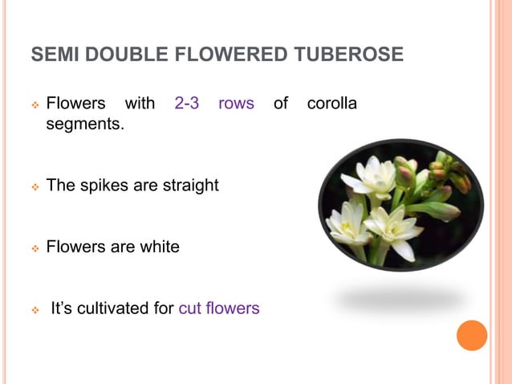
B.Sc. (Ag.) IV Sem. (Production Technology for Ornamental Crops, MAP and Landscaping)

Slide 11
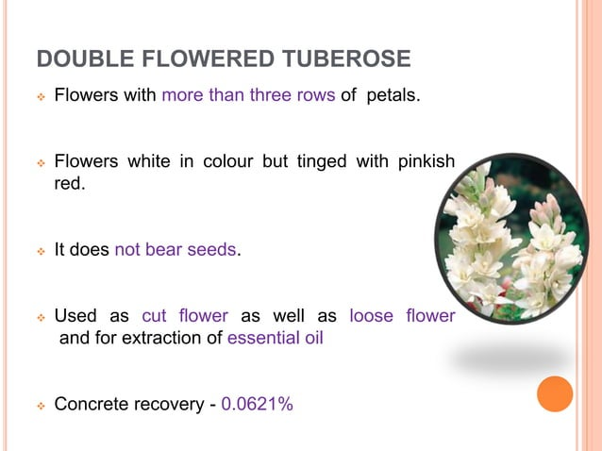
B.Sc. (Ag.) IV Sem. (Production Technology for Ornamental Crops, MAP and Landscaping)

Slide 12
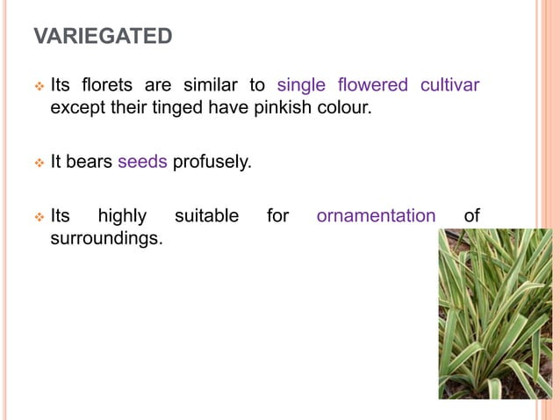
B.Sc. (Ag.) IV Sem. (Production Technology for Ornamental Crops, MAP and Landscaping)

Slide 13
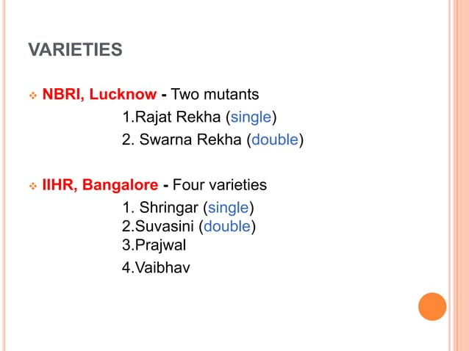
B.Sc. (Ag.) IV Sem. (Production Technology for Ornamental Crops, MAP and Landscaping)

Slide 14
Soil
Tuberose can be grown on wide variety of soils from light, sandy loam to a clay loam.
The soil should be at least 45 cm deep, well drained, friable, rich in organic matter
The soil should have a pH range from 6.5 to 7.5 with good aeration.
Climate
The crop is best suited for cultivation in tropical to subtropical and temperate climates.
The crop is reported to flower profusely throughout the year, if the climate is mild and free from extremes of high and low temperature.
A temperature range from 20-30°C is considered ideal
for this crop.
B.Sc. (Ag.) IV Sem. (Production Technology for Ornamental Crops, MAP and Landscaping)

Slide 15
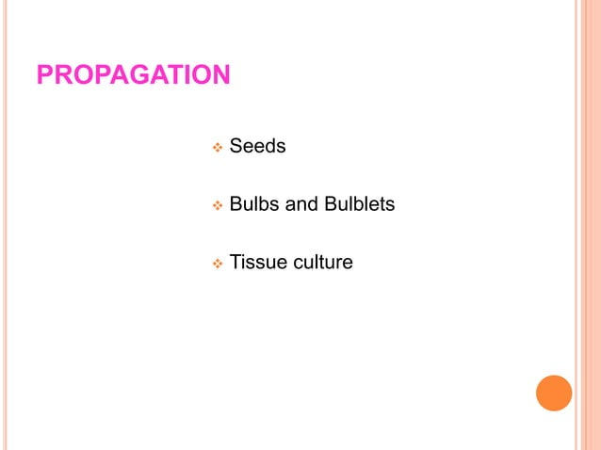
B.Sc. (Ag.) IV Sem. (Production Technology for Ornamental Crops, MAP and Landscaping)

Slide 16
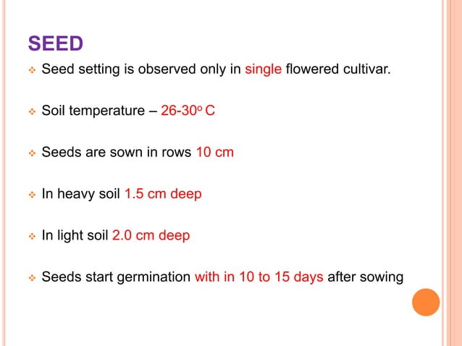
B.Sc. (Ag.) IV Sem. (Production Technology for Ornamental Crops, MAP and Landscaping)

Slide 17
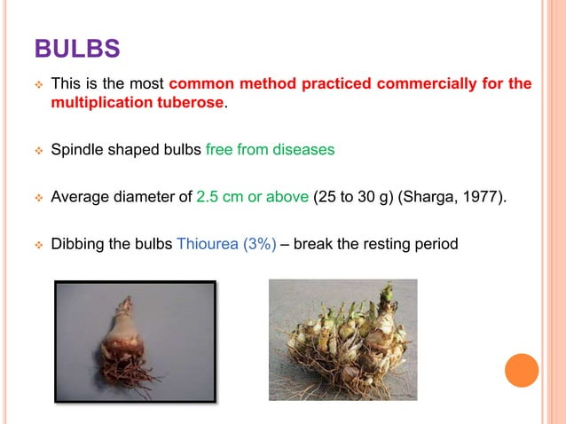
B.Sc. (Ag.) IV Sem. (Production Technology for Ornamental Crops, MAP and Landscaping)

Slide 18
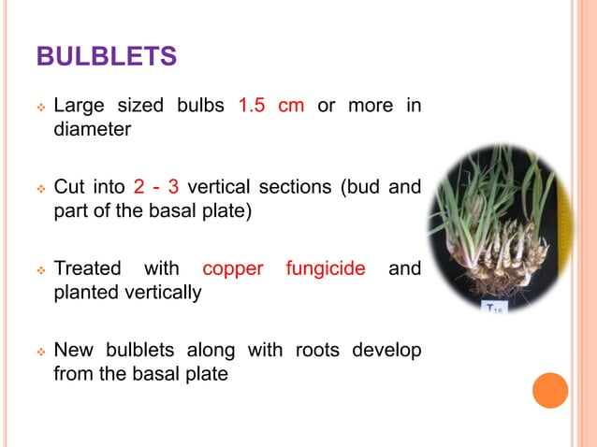
B.Sc. (Ag.) IV Sem. (Production Technology for Ornamental Crops, MAP and Landscaping)

Slide 19
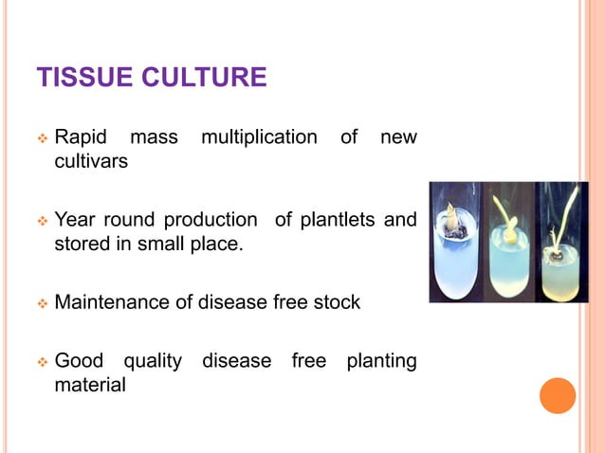
B.Sc. (Ag.) IV Sem. (Production Technology for Ornamental Crops, MAP and Landscaping)

Slide 20
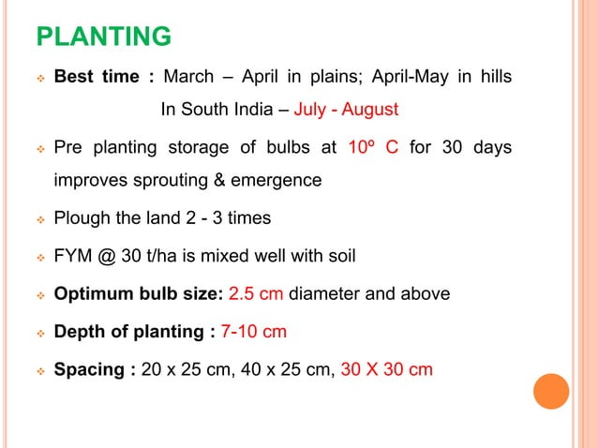
B.Sc. (Ag.) IV Sem. (Production Technology for Ornamental Crops, MAP and Landscaping)

Slide 21
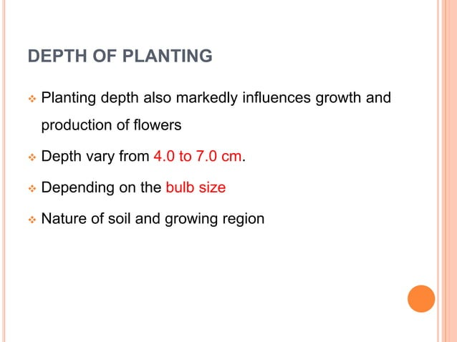
B.Sc. (Ag.) IV Sem. (Production Technology for Ornamental Crops, MAP and Landscaping)

Slide 22
Fertilizer application
100 kg N, 60 kg P₂O₅ and 40 kg K₂O /ha is recommended for tuberose production.
Of the full recommended dose of fertilizers, half the N, the full dose of P and K has to be applied at the time of planting and the remaining half of N is given as a top- dressing after 45 days of planting
Irrigation
Subsequently, the crop is irrigated at 5-7 days intervals depending upon weather conditions.
In the summer months, irrigation is recommended twice a week.
Effect of Growth regulators
Application of both CCC at 5000 ppm and GA3 at 1000 ppm results in early flowering, increased flower stalk, number of flower florets production and improves the quality of flowers
Intercultural operations
In order to keep the plots free of weeds and to avoid the exposure of bulbs, the plots are weeded and earthed-up once a month.
The application of Atrazine (@ 3 kg/ha) as a pre- eme8rgent weedicide keeps the plots weed-free.
B.Sc. (Ag.) IV Sem. (Production Technology for Ornamental Crops, MAP and Landscaping)

Slide 23
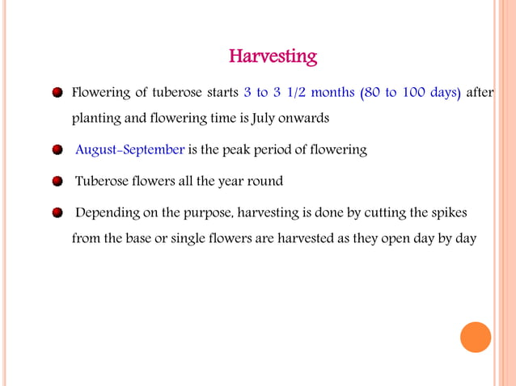
B.Sc. (Ag.) IV Sem. (Production Technology for Ornamental Crops, MAP and Landscaping)

Slide 24
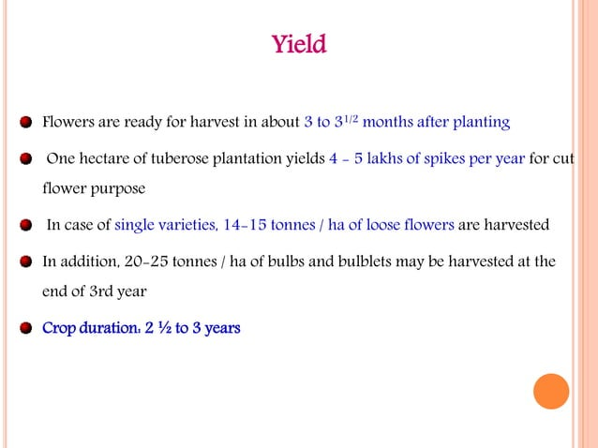
B.Sc. (Ag.) IV Sem. (Production Technology for Ornamental Crops, MAP and Landscaping)

Slide 25
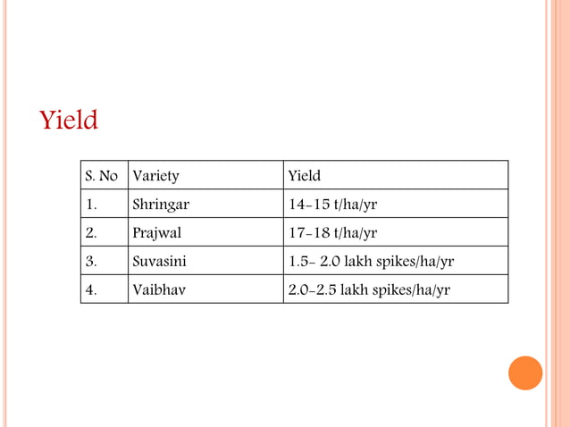
B.Sc. (Ag.) IV Sem. (Production Technology for Ornamental Crops, MAP and Landscaping)

Slide 26
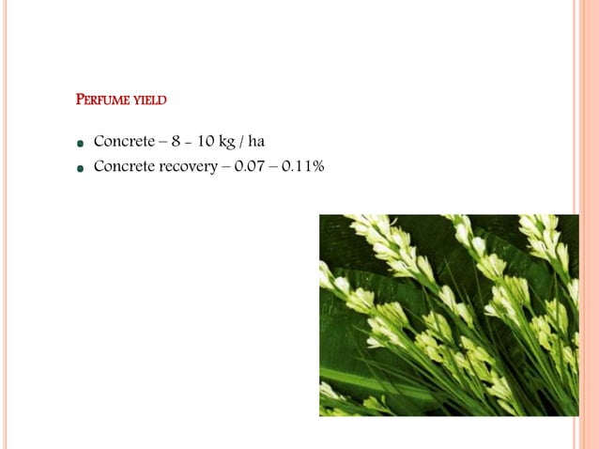
B.Sc. (Ag.) IV Sem. (Production Technology for Ornamental Crops, MAP and Landscaping)

Slide 27
Pests of tuberose
Aphids
Grasshoppers
Red spider mites
Thrips
Root-knot nematode and greasy streak nematode
Diseases of tuberose
Stem rot
Flower Bud rot
Leaf blight or Botrytis blight
Alternaria leaf spot
B.Sc. (Ag.) IV Sem. (Production Technology for Ornamental Crops, MAP and Landscaping)

